Slide 1

.NET TRAINING SESSION
DELEGATES & EVENTS

Slide 2
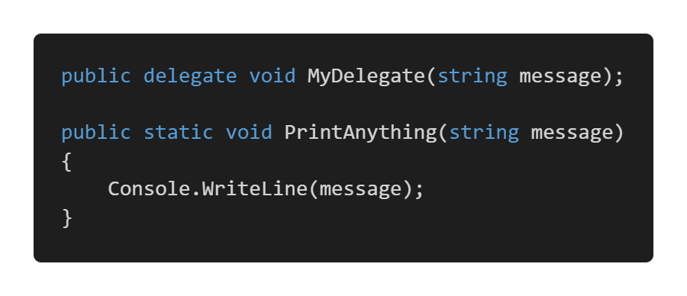
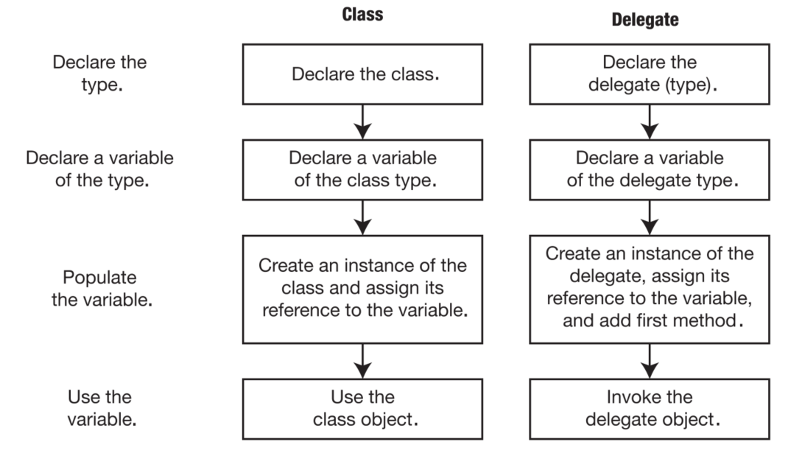
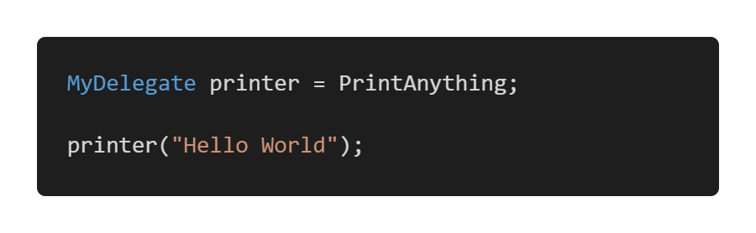
Delegates
A delegate is a type that represents references to methods with a particular parameter list and return type.

Slide 3
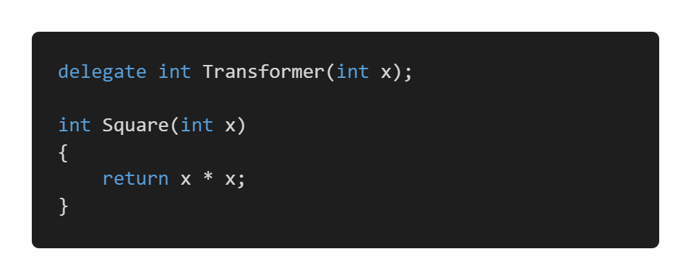
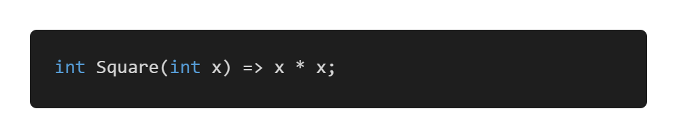
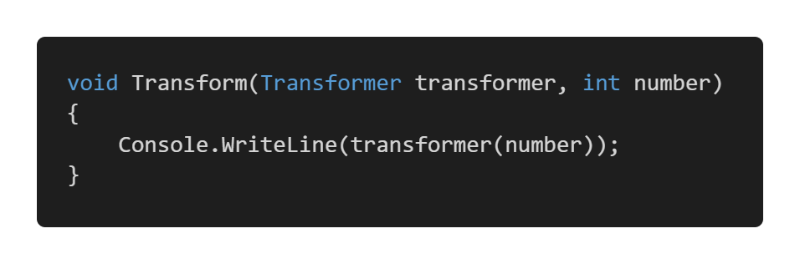
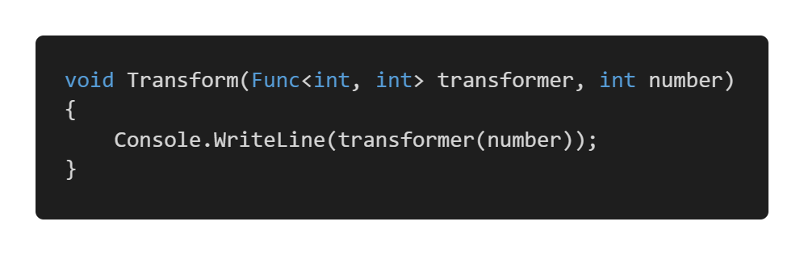
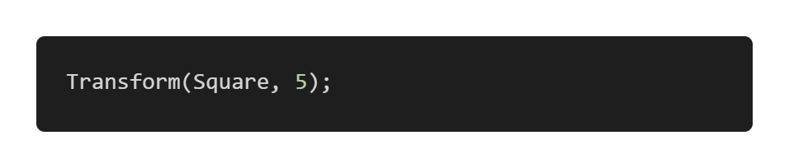

A higher order function is a function that takes a function as an argument or returns a function.
The code can be rewritten as

Slide 4
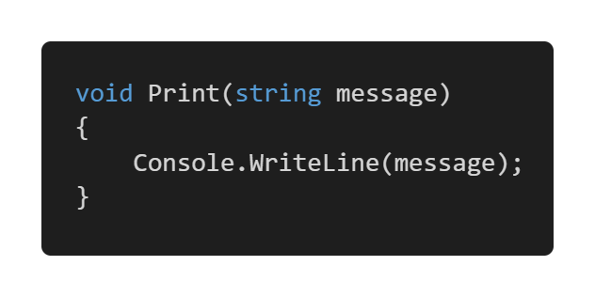
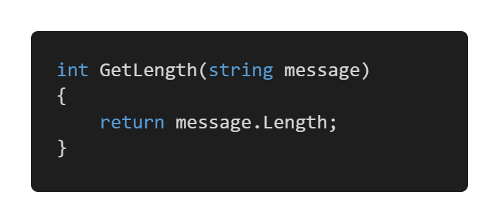
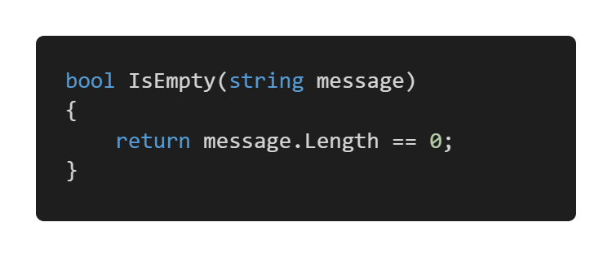
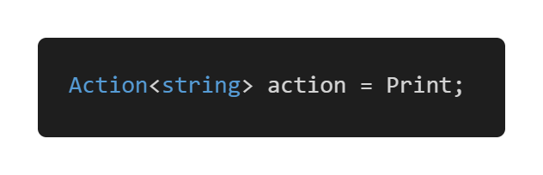
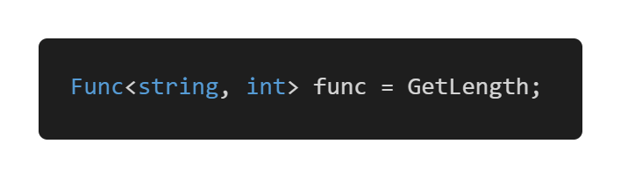
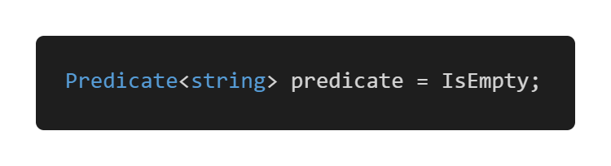
Particular delegates
Action<T> | Func<T, TResult> | Predicate<T>
T represents input type | T represents input type | T represents input type
Returns void | Returns type TResult | Returns bool
Supports multiple parameters | Supports multiple parameters but the last one will be the return type | Do not supports multiple parameters

Slide 5
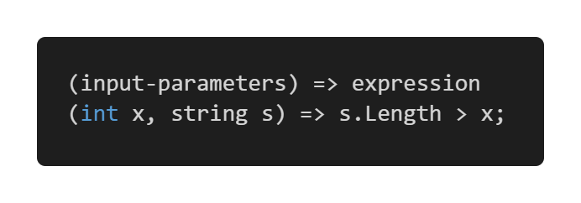
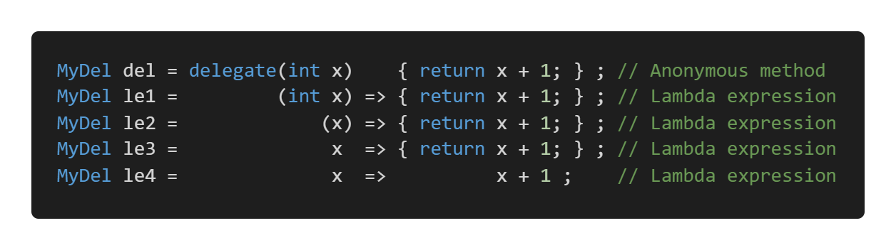
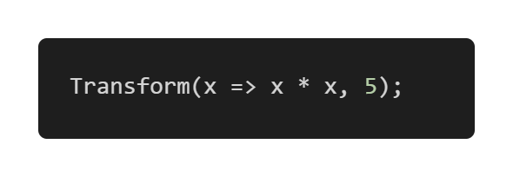
Lambda expressions
A lambda expression is an unnamed method written in place of a delegate instance.
So our transformer could be called more easily like this

Slide 6
Delegates are used in the following cases:
Event handlers
Callbacks
LINQ
Implementation of design patterns
There is nothing that is done with delegates that cannot be done with regular methods. Delegates are used because they bring several advantages. They foster flexibility of the application and code reuse. Like interfaces, delegates let us decouple and generalize our code. Delegates also allow methods to be passed as parameters. When we need to decide which method to call at runtime, we use a delegate.

Slide 7
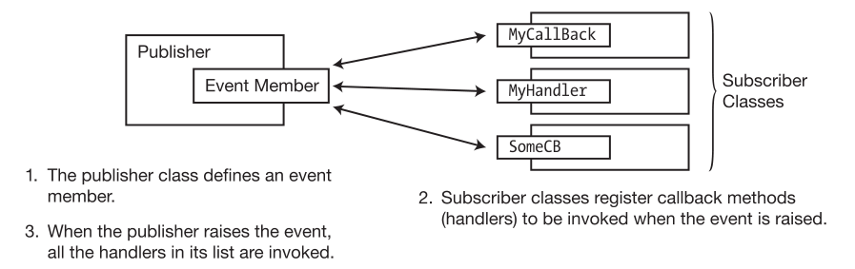
Events
One common requirement in many programs is that when a particular program event occurs, other parts of the program need to be notified that the event has occurred. One pattern for satisfying this requirement is called the publisher/subscriber pattern. In this pattern, a class, called the publisher, defines a set of events that other parts of the program might be interested in.
Other classes can then “sign up” to be notified by the publisher when these events occur. These subscriber classes “sign up” for notification by supplying a method to the publisher. When the event occurs, the publisher “raises the event,” and all the methods submitted by the subscribers are executed.

Slide 8
